Slide 1
STEVE JOBS
Presented by 李昀哲

Slide 2

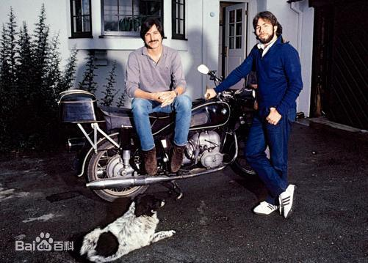
1955 - 2011
Notes:
TO SHOW HE IS UNIQUE

Slide 3
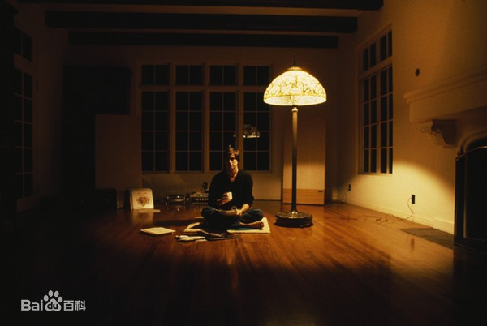
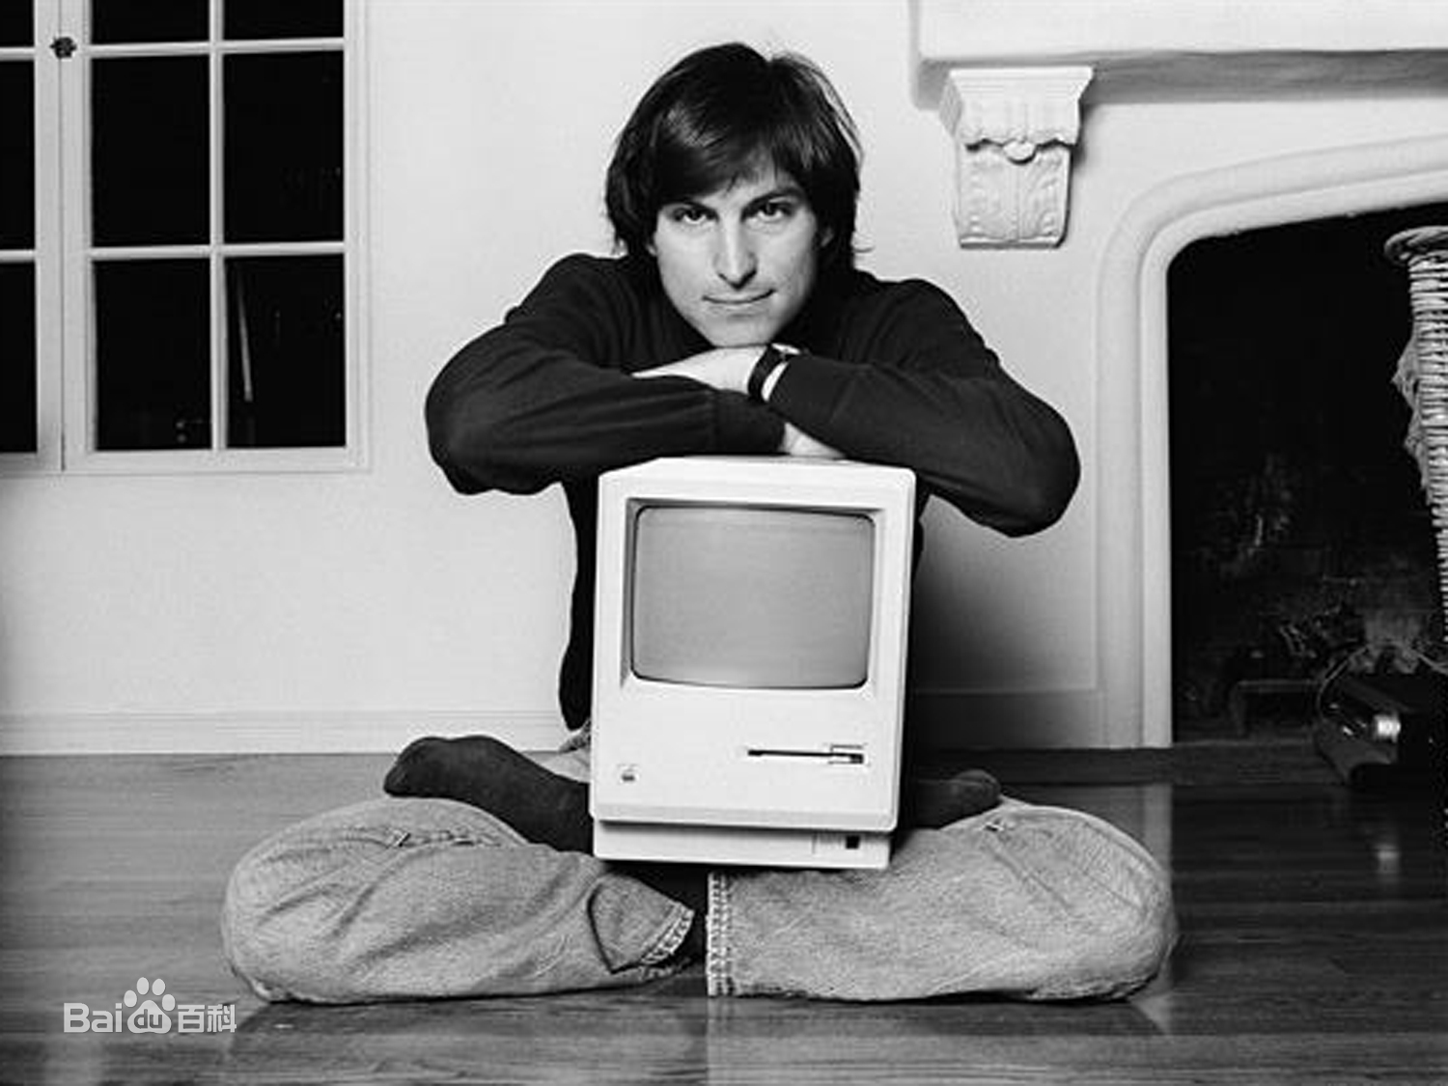
Zen Idea

Slide 4
2001 iPod
2010 iPad
1980 Apple II
1998 iMac
2007 iPhone
1983 LISA
1976 Apple I
Notes:
business is bleak

